Slide 1
CELEBREMOS
By
Sairam Badisa
Karun Bourishetty
Indra Reddy Mamidi
Hari Priya Jupally
Poojitha Singam
Saikumar Nalivela
Vishal Reddy Pannala

Slide 2
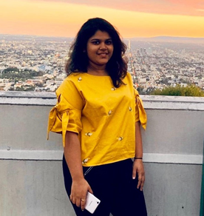
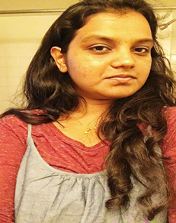
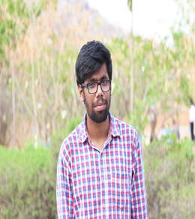
Team Members
Hari Priya Jupally
Poojitha Singham
Sairam Badisa

Slide 3
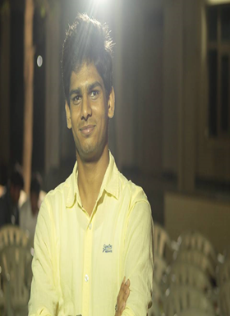
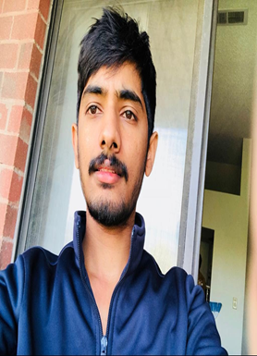
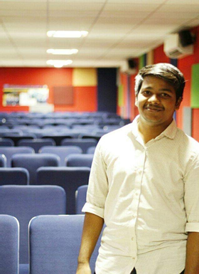
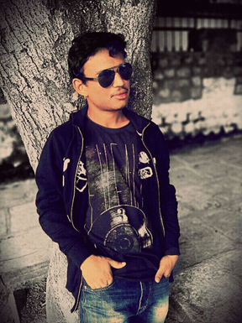
Team Members
Saikumar Nalivela
Indra Reddy Mamidi
Karun Bourishetty
Vishal Reddy Pannala

Slide 4
Outline
Description of project.
Register and Login.
Creating an event.
Adding the contact using CSV file.
Event Dashboard.
SMS invitation.
RSVP for the event and Poll.
Contacts.
Invitee Login.
Conclusion.
Hari Priya Jupally

Slide 5
Project description
Our project “Celebremos” is a web application that is used to send an online invitation
Via email or
Via sms
Our project allows users to create, edit and manage event successfully.
Hari Priya Jupally

Slide 6
Project description(cont..)
Our project helps the users to create new invitation or use existing templates.
Once the invitation is sent, we can either accept, reject or save it for later.
Hari Priya Jupally

Slide 7
Register and Login
Before logging into the application we need to register.
If you forget your password then you can reset it.
We need to login to our application with the registered credentials.
Once we login we get redirected to the create an invitation page.
Hari Priya Jupally

Slide 8
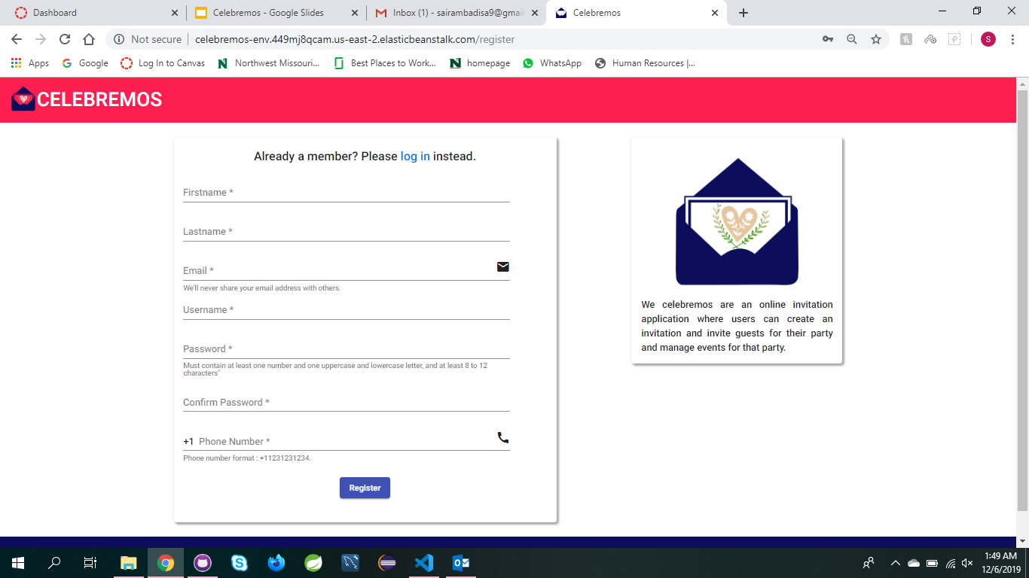
Register page snap

Slide 9
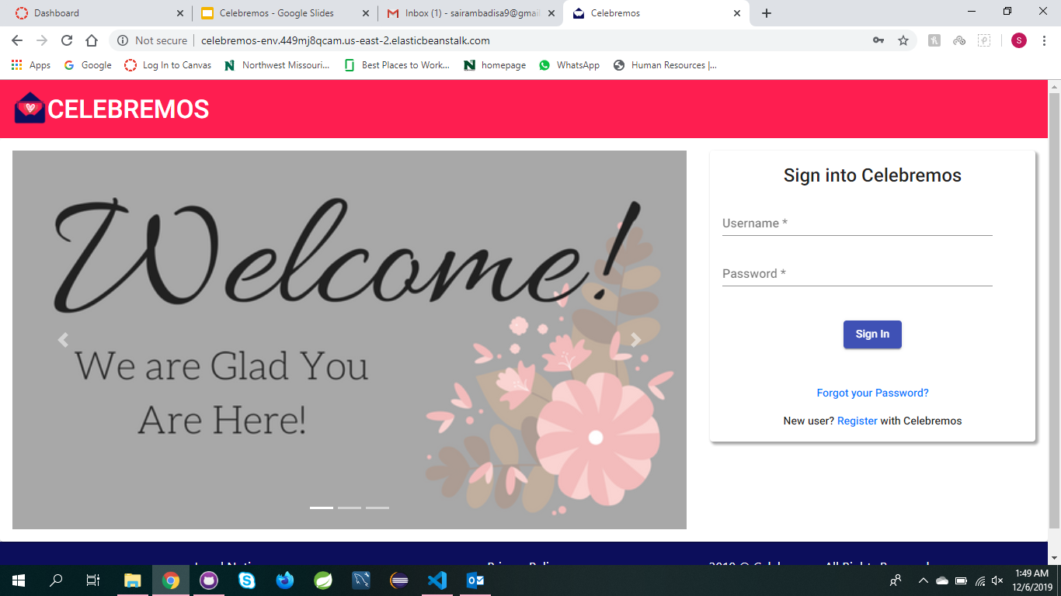
Login page snap

Slide 10
Creating an event
User can create event and send invitation to their guests.
User can save the invitation for future use or preview the template and send invitations.
User can import a csv file so that they can choose the contacts from the file.
User is allowed to provide any extra additional information.
Hari Priya Jupally

Slide 11
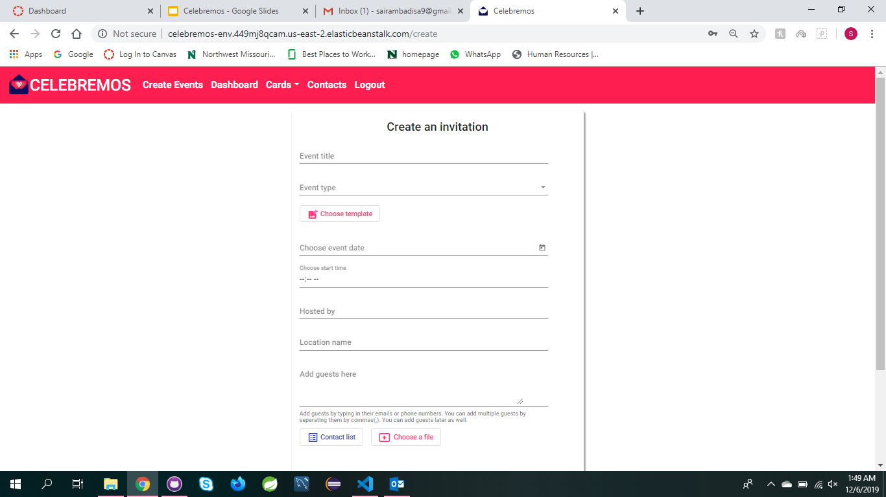
Creating an event

Slide 12
Creating an event
User can always save the event for later use.
Two things that are very important while filling the form
Enter the correct values
Do not leave mandatory fields empty.
After entering all the details we can check that down in the database connected to the server.
Poojitha Singam

Slide 13
Adding the contacts using CSV file
When creating the event we can import contacts using three ways. They are :-
Giving direct contact details
Importing CSV file.
Selecting from group contact.
Users are allowed to upload the csv (comma separated values) file which has list of guests email ids or mobile numbers.
Poojitha Singam

Slide 14
Event Dashboard
This is one of the important part of the application.
We can see couple of functionalities like:
Saved Events.
Invited Events.
Hosted Events.
Hosted Events are those which are hosted by the host.
Invited Events are those invited by others
(cont..)
Sairam Badiaa

Slide 15
Event Dashboard
Saved Events are those saved for later use.
Information about the event like no.of guests attending and not can be clearly seen.
Also we can edit the event by changing the details by using edit option.
Sairam Badiaa

Slide 16
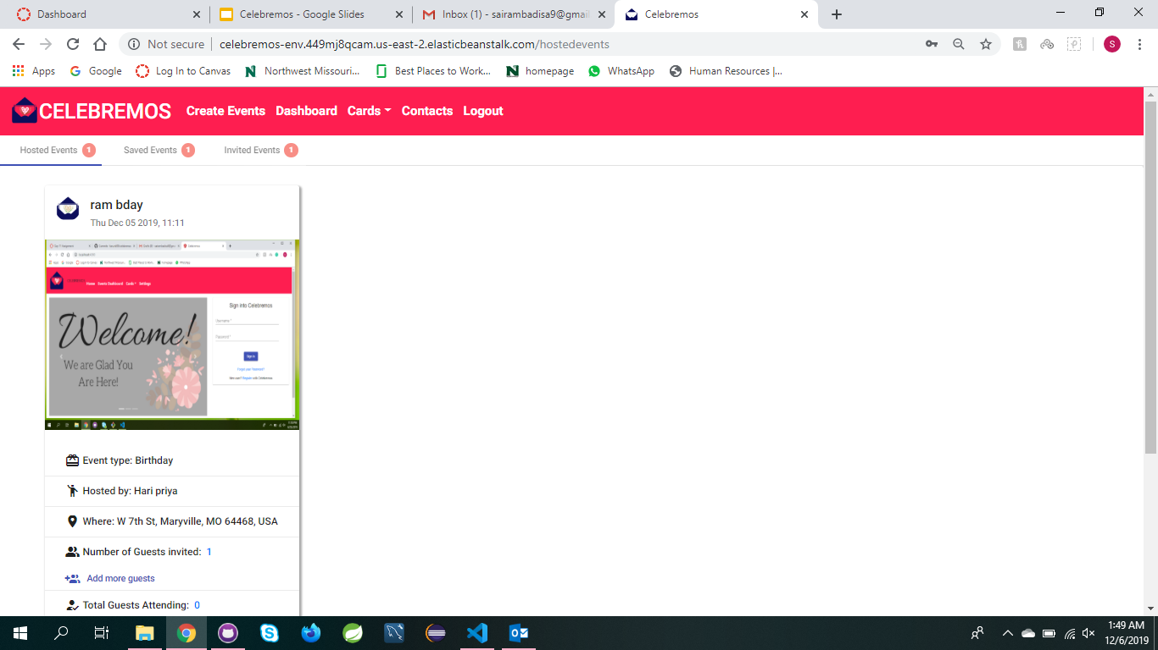
Event Dashboard

Slide 17
SMS Invitation
There might be high chances of the people who may not have the access to their email ids.
In that case we can send a text message to their mobiles.
This text message includes the details about the event.
From the response given by the guests, the host can make a note of the count of number of people.
Saikumar Nalivela

Slide 18
Poll for the event
We can add the poll by using the continue option while creating the event.
When creating an event there’s option like adding a poll.
Also we can include the Items to bring and add food menu.
Saikumar Nalivela

Slide 19
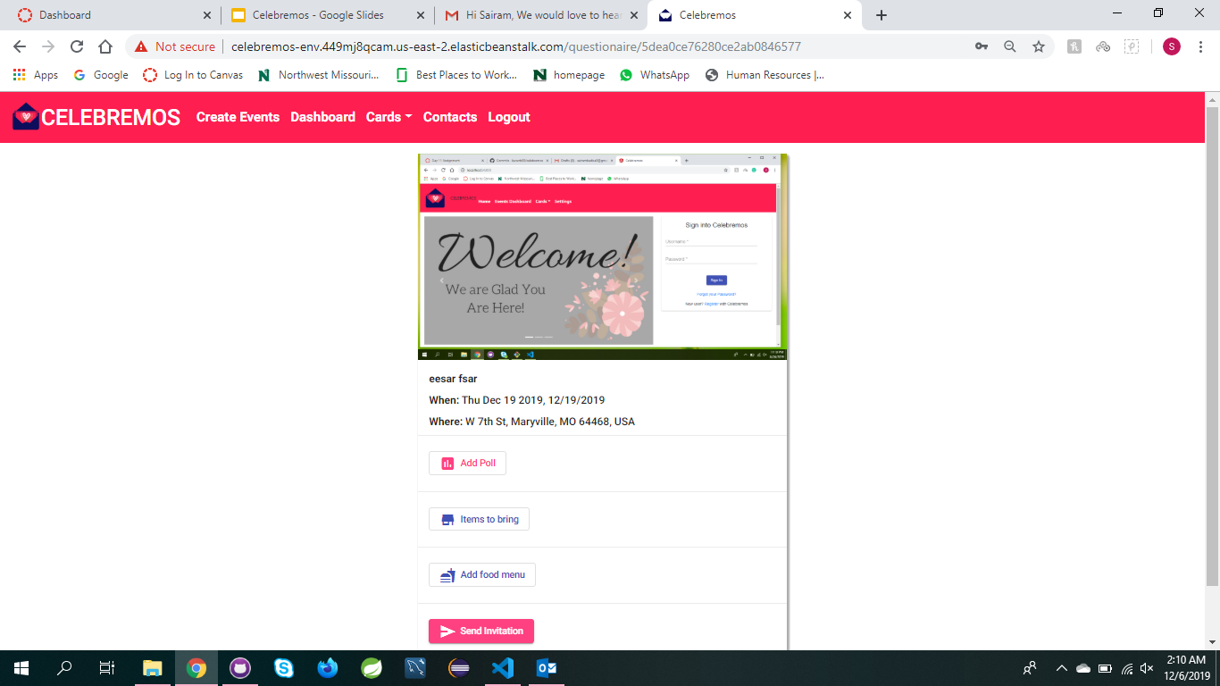
Poll for the event

Slide 20
RSVP for the event
The RSVP in this application where the hosts should make sure about the number of guests that are attending.
Hosts should make a note of all the details given by guests.
The hosts should make arrangements for the event, based on the number of guests.
Indra Reddy Mamidi

Slide 21
Contacts
In this contacts module, we can create groups and include the contacts in the group.
Also we can edit or delete the contact.
We can select all the contacts at a time while sending the invitation.
Also we can search the contact in the search bar.
Karun Bourishetty

Slide 22
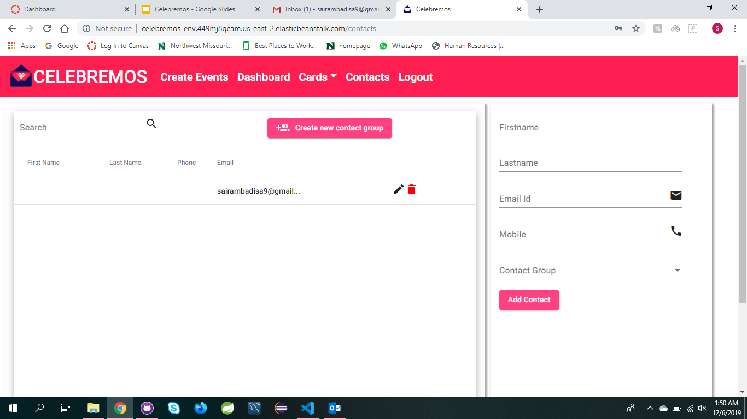
Contacts

Slide 23
Invitee Login
After sending the invitation to the guests, they get the mail or the message where they should give the RSVP to the invitation.
If the guests accept the invitation we can see the event on the invited events tab.
Also they can the edit the response and answer to the polls.
There’s a option like posing a question to the host.
Vishal Reddy Pannala

Slide 24
Conclusion
By using this web application we can host an event successfully.
Anyone can have a great experience by using this application.
This application on a whole gives you a great experience in hosting a memorable event.
Vishal Reddy Pannala

Slide 25
Any Questions?
Sairam Badisa
Poojitha Singham
Hari Priya Jupally

Slide 26
Any Questions?
Saikumar Nalivela
Indra Reddy Mamidi
Vishal Reddy Pannala
Karun Bourishetty

Slide 27
Thank You

